Slide 1

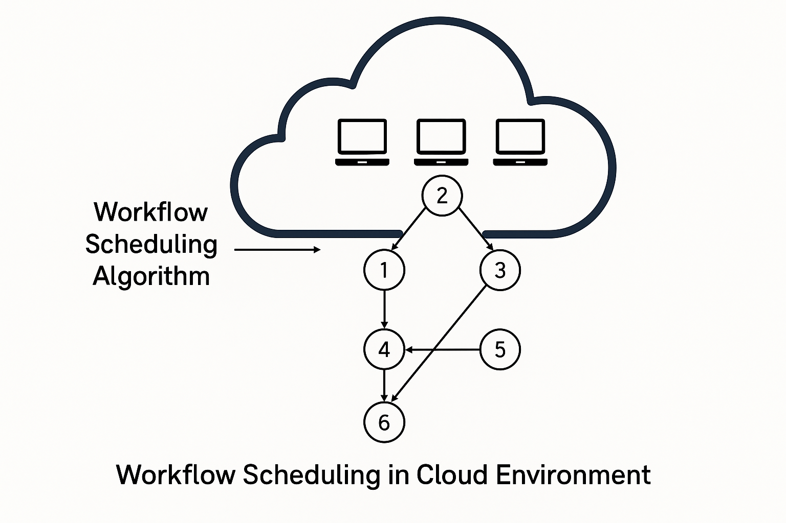
Workflow Scheduling using Reinforcement Learning in Cloud Environment
Presented By: - Yash Yadav (12113046)

Slide 2
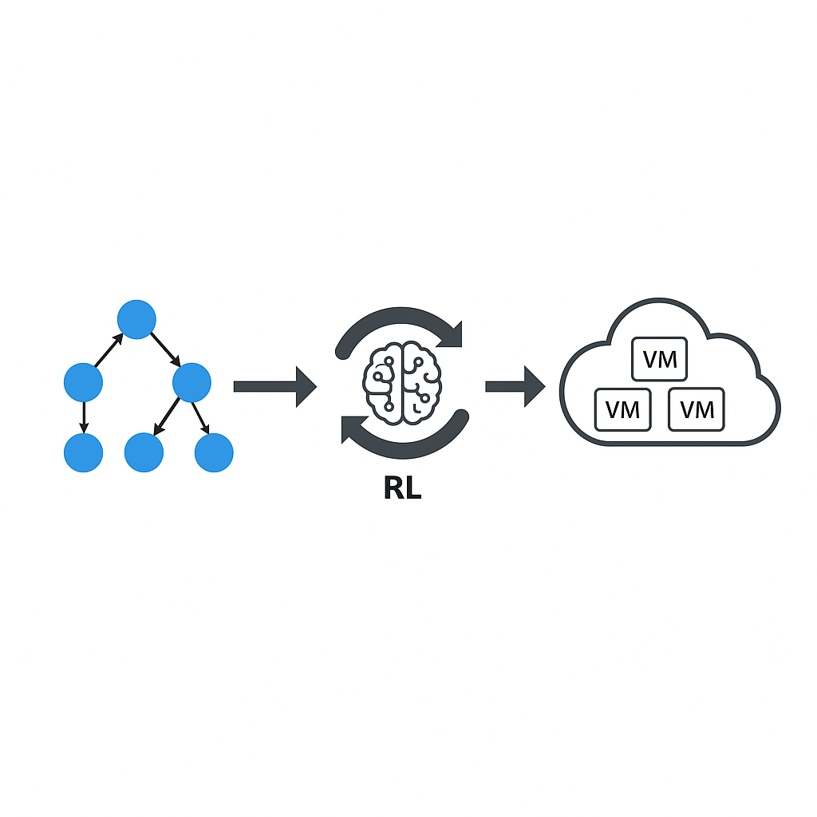
Introduction:
Cloud computing enables scalable and flexible access to computing resources, revolutionizing the way applications are executed. Workflow applications, often represented as Directed Acyclic Graphs (DAGs), depend on efficient task scheduling across Virtual Machines (VMs) to maximize performance.
Traditional scheduling methods face challenges in dynamic and high-load cloud environments. Reinforcement Learning (RL), specifically Deep Q-Networks (DQN), provides an intelligent, adaptive solution, significantly improving resource utilization, minimizing execution time (makespan), and enhancing scheduling efficiency under varying workloads.

Slide 3
Contributions and Project Outline:
Intelligent Workflow Scheduling: The project introduces a framework that uses Deep Q-Network (DQN), a reinforcement learning technique, to intelligently schedule workflows in cloud environments.
Task Scheduling Across Virtual Machines: The framework dynamically assigns tasks to virtual machines (VMs) with the goal of minimizing makespan and optimizing resource usage.
Real-time Adaptation: It adapts in real-time to changing workloads, ensuring that tasks are executed efficiently and resources are utilized effectively.
Neural Network for Q-Table: Instead of using a traditional Q-table, the framework employs a neural network to handle task scheduling decisions, enhancing scalability and adaptability.
Critical-Path Based Task Ranking: The framework includes a task ranking strategy based on the critical path, which helps prioritize tasks for optimal scheduling.
Dynamic Scheduling with Experience Replay and ε-Greedy Exploration: The system enables dynamic scheduling through techniques like experience replay and ε-greedy exploration, allowing for continuous improvement and learning.

Slide 4
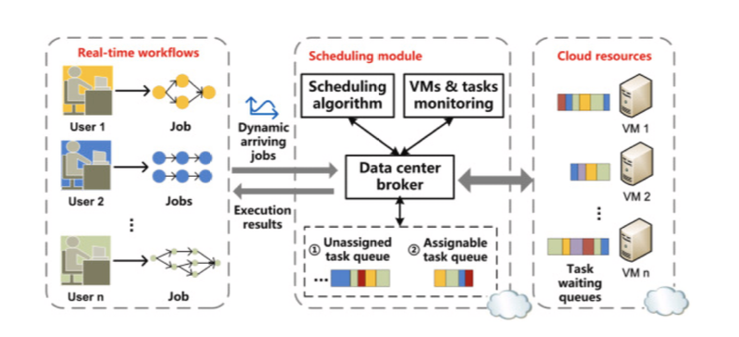
Contributions and Project Outline:
Key Points:
Intelligent Scheduling: Uses Deep Q-Network (DQN) for adaptive and efficient workflow scheduling in the cloud.
Neural Network Approximation: Replaces Q-table with a neural network to handle large state spaces and complex task-VM mappings.
Task Ranking Mechanism: Inspired by HEFT algorithm; prioritizes tasks based on execution and communication costs to minimize workflow time.
Dynamic Learning: Employs experience replay and ε-greedy strategies for continuous learning and better scheduling decisions.

Slide 5
Problem with Traditional Q-Learning:
Q-table in Traditional Q-Learning:
Q-values are stored in a matrix, where rows represent states and columns represent actions.
Issue: Exponentially growing Q-table in large or continuous state spaces, making it impractical for cloud environments.
Solution: Replacing Q-Table with Deep Neural Network (DNN):
In Deep Q-Network (DQN), instead of storing Q-values in a matrix, we use a Deep Neural Network (DNN) to approximate the Q-function: Q(s, a; θ) ≈ Q∗(s, a) , where:
Q(s, a; θ) is the predicted Q-value from the neural network,
θ represents the weights of the neural network,
Q∗(s, a) is the optimal Q-value learned over time.

Slide 6
Problem Formulation (Markov Decision Process - MDP):-
State (S):
Represents current cloud environment.
Includes VM utilization, pending tasks, and resource availability.
Action (A):
Assigns a workflow task to a VM.
Reward (R):
Encourages efficient scheduling by minimizing makespan and balancing workloads.
State Transition:
Moves to the next state after executing an action.
Environment
State
Action
Reward
Agent

Slide 7
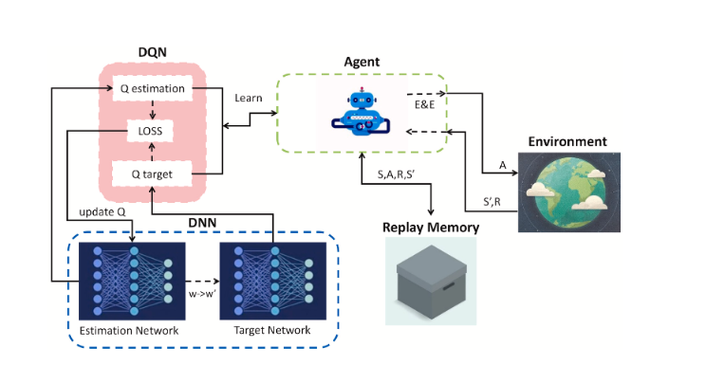
Working Process of the Algorithm:-
Initialize the Environment
Define workflows, virtual machines (VMs), and resource constraints.
Simulate the cloud environment to represent task execution and scheduling.
Initialize the DQN Model
Construct a deep neural network to approximate Q-values.
The Q-values guide decisions on task-to-VM assignment.
Execute Training Process
Observe the Current State: Monitor VM status and task queue.
Action Selection: Use ε-greedy strategy for balancing exploration vs. exploitation.
Execute Actions: Perform actions and receive rewards based on task scheduling.
Replay Memory: Store experiences for future learning.
Update DQN Model: Use mini-batch Q-learning to refine the model.
Deploy the Trained Model
Use the optimized DQN model for real-time workflow task scheduling.
Achieve dynamic and efficient task allocation in the cloud environment.

Slide 8
Task Ranking and Communication Cost Calculation:
Task Ranking Strategy
Reverse Topological Order: Process tasks from exit nodes backward.
Exit Tasks: Rank = execution time.
Other Tasks:
Formula: rank(t) = exec time(t) + max [rank(c) + avg_common_cost(t, c)]
Sorting: Tasks sorted in descending order, prioritizing the critical path.
Advantages Over Topological Sort
Incorporates Execution & Communication Costs: Provides a more accurate task priority.
Critical Path Focus: Prioritizes time-sensitive tasks, improving scheduling efficiency.
Communication Cost Calculation:
Same Virtual Machine (VM): Communication cost = local latency Lm.
Different VMs:
Formula: C(Ti, Tk, V Mm, V Mn) = Lm + (Di,k / Bm,n)
Where Di,k is the data size and Bm,n is the available bandwidth.
Reward Function Design:
Purpose: Ensures stability and convergence in multi-agent learning.
Formula: w1=(Et_{k,i,j}(a) − (makespan′ − makespan)**3)/ Et_{k,i,j}(a)
Impact: Drives efficient task scheduling by rewarding makespan reduction.

Slide 9
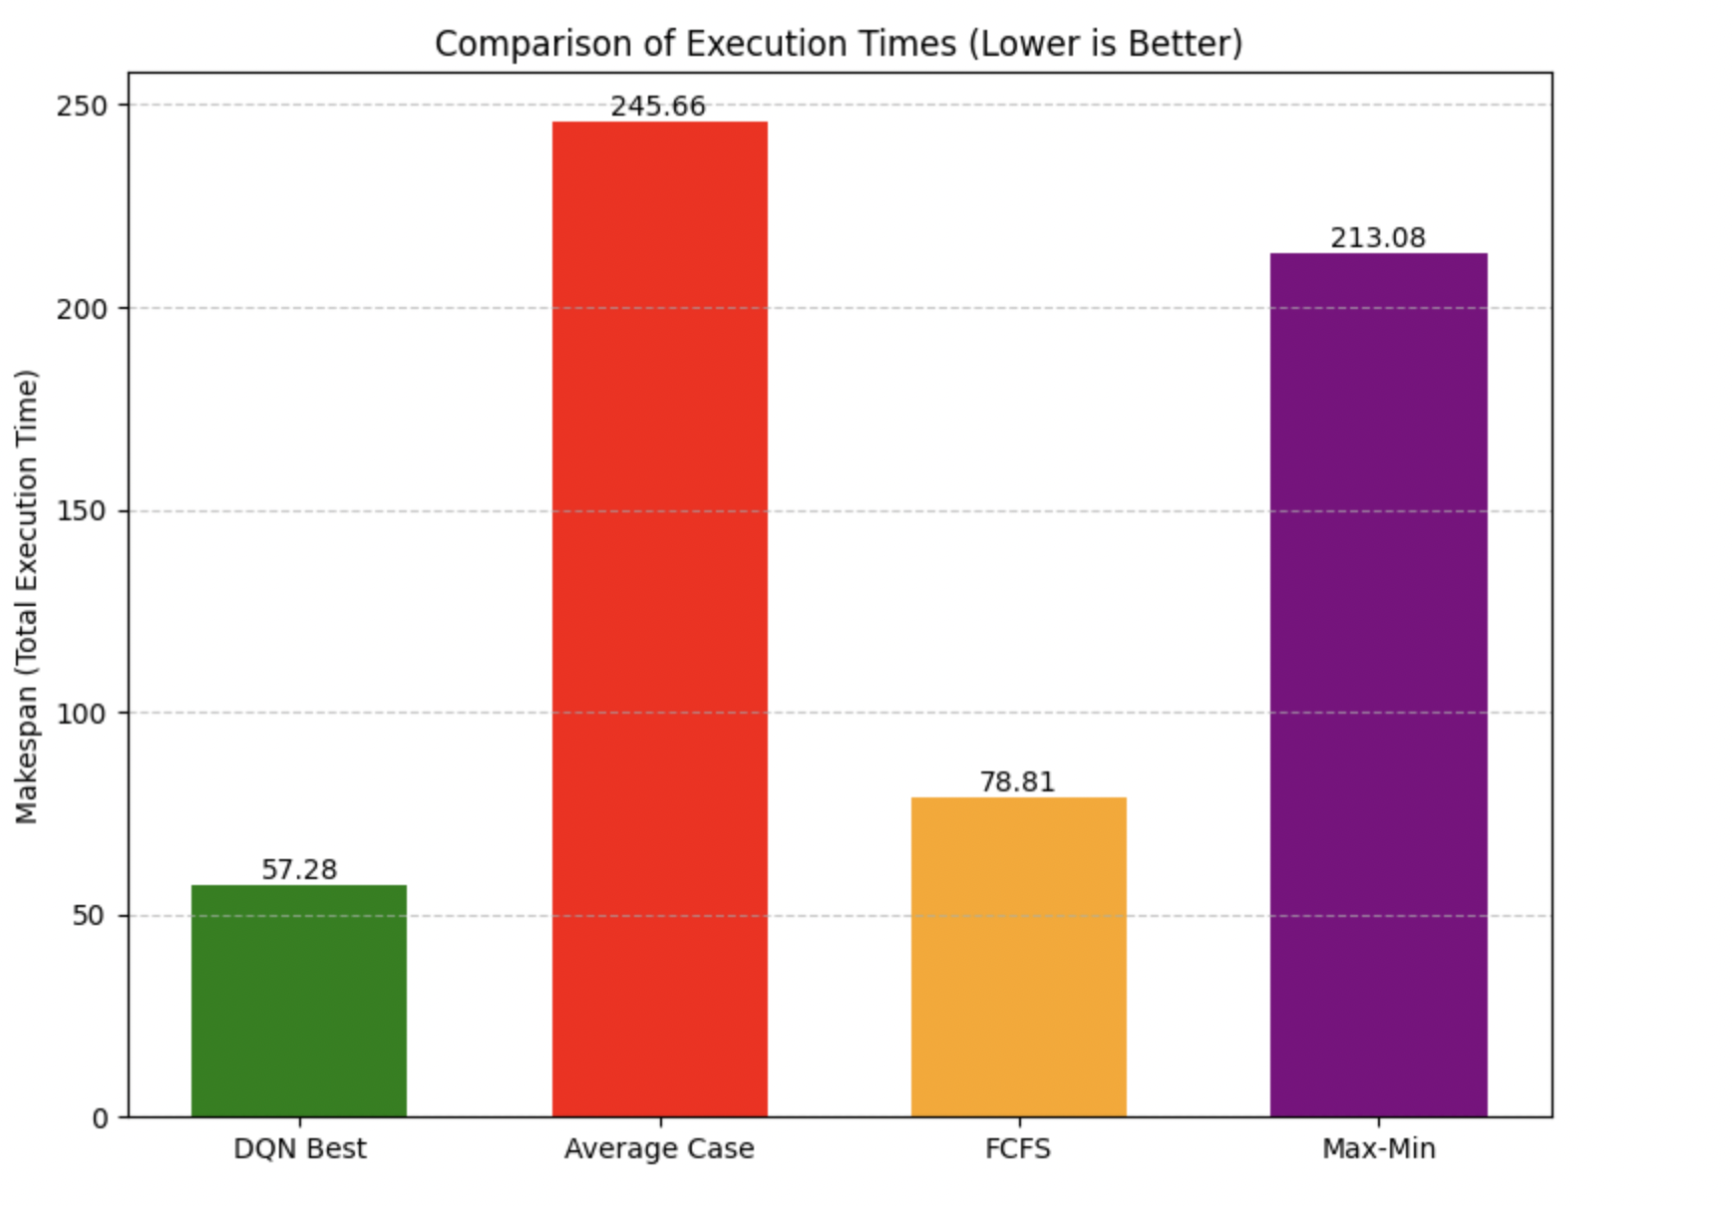
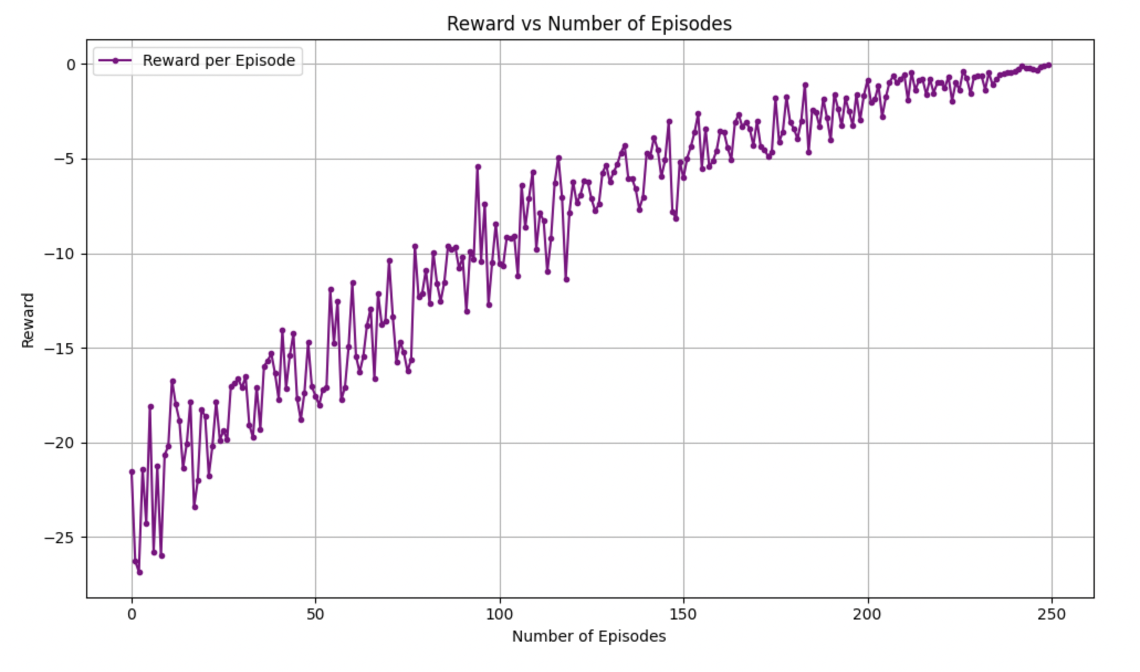
Performance Analysis with varying number of tasks and virtual machines:-
No. of tasks: 50, No. of VMs: 5

Slide 10
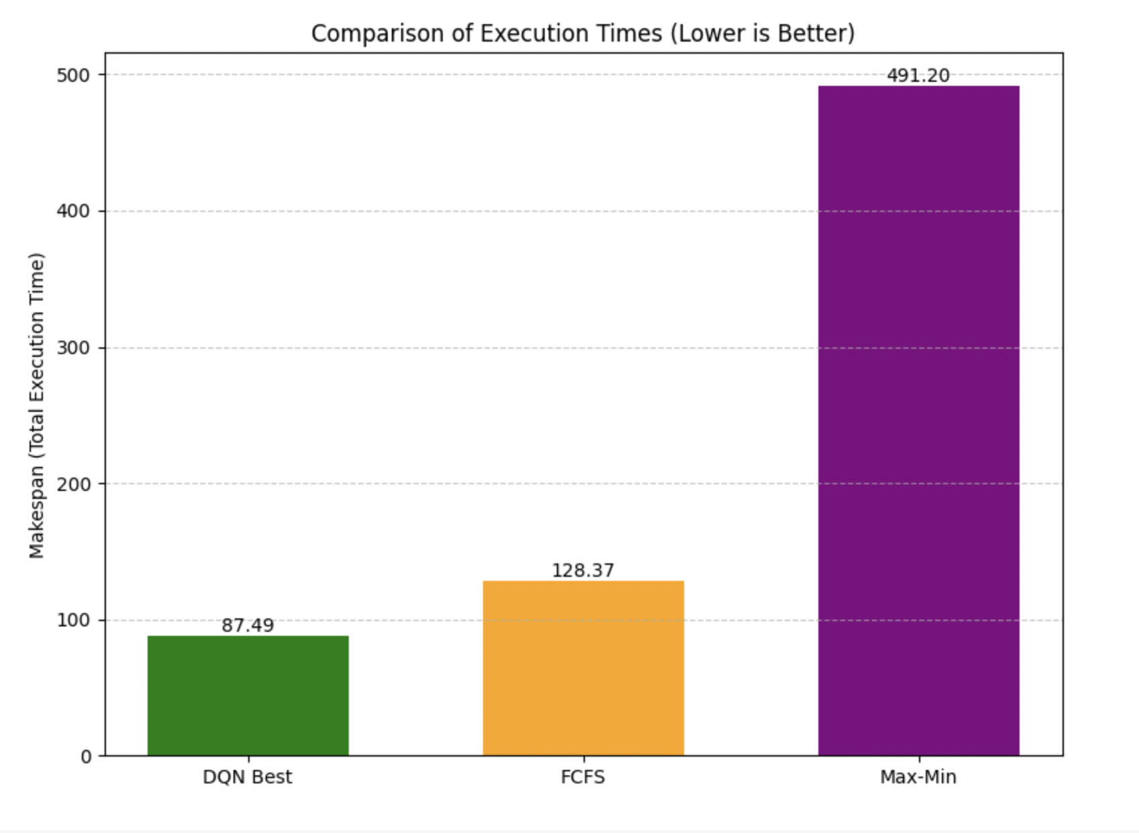
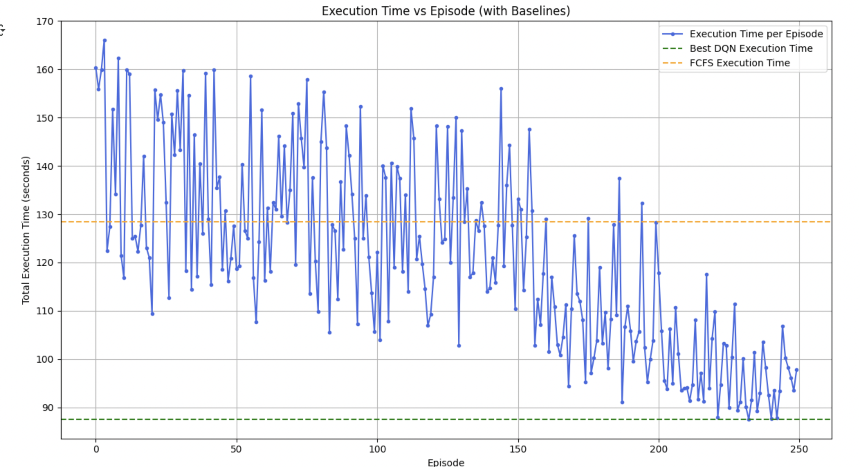
Performance Analysis with varying number of tasks and virtual machines:-
No. of tasks: 100, No. of VMs: 5

Slide 11
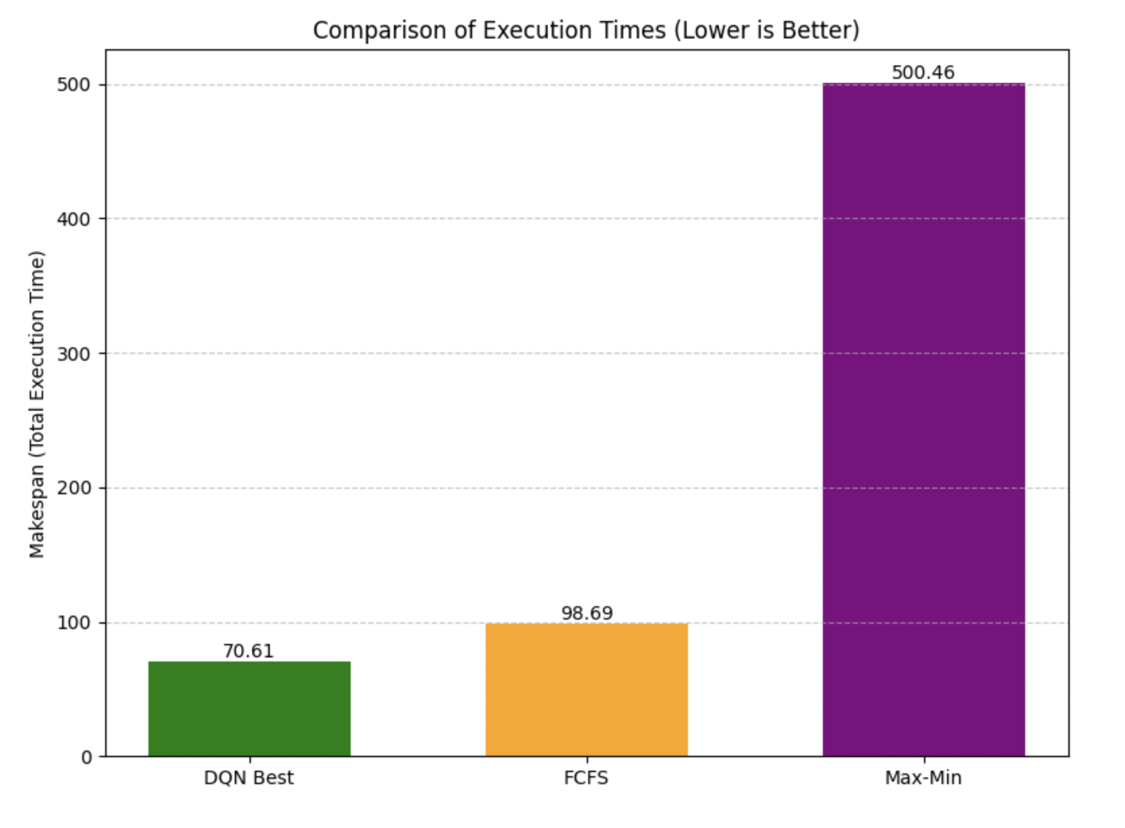
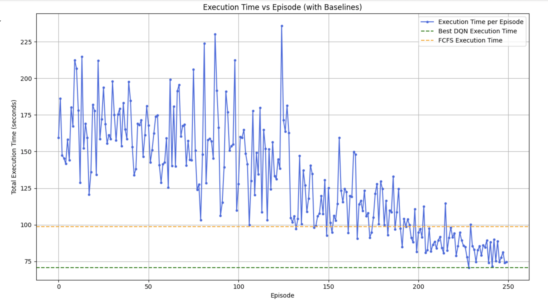
Performance Analysis with varying number of tasks and virtual machines:-
No. of tasks: 100, No. of VMs: 10

Slide 12
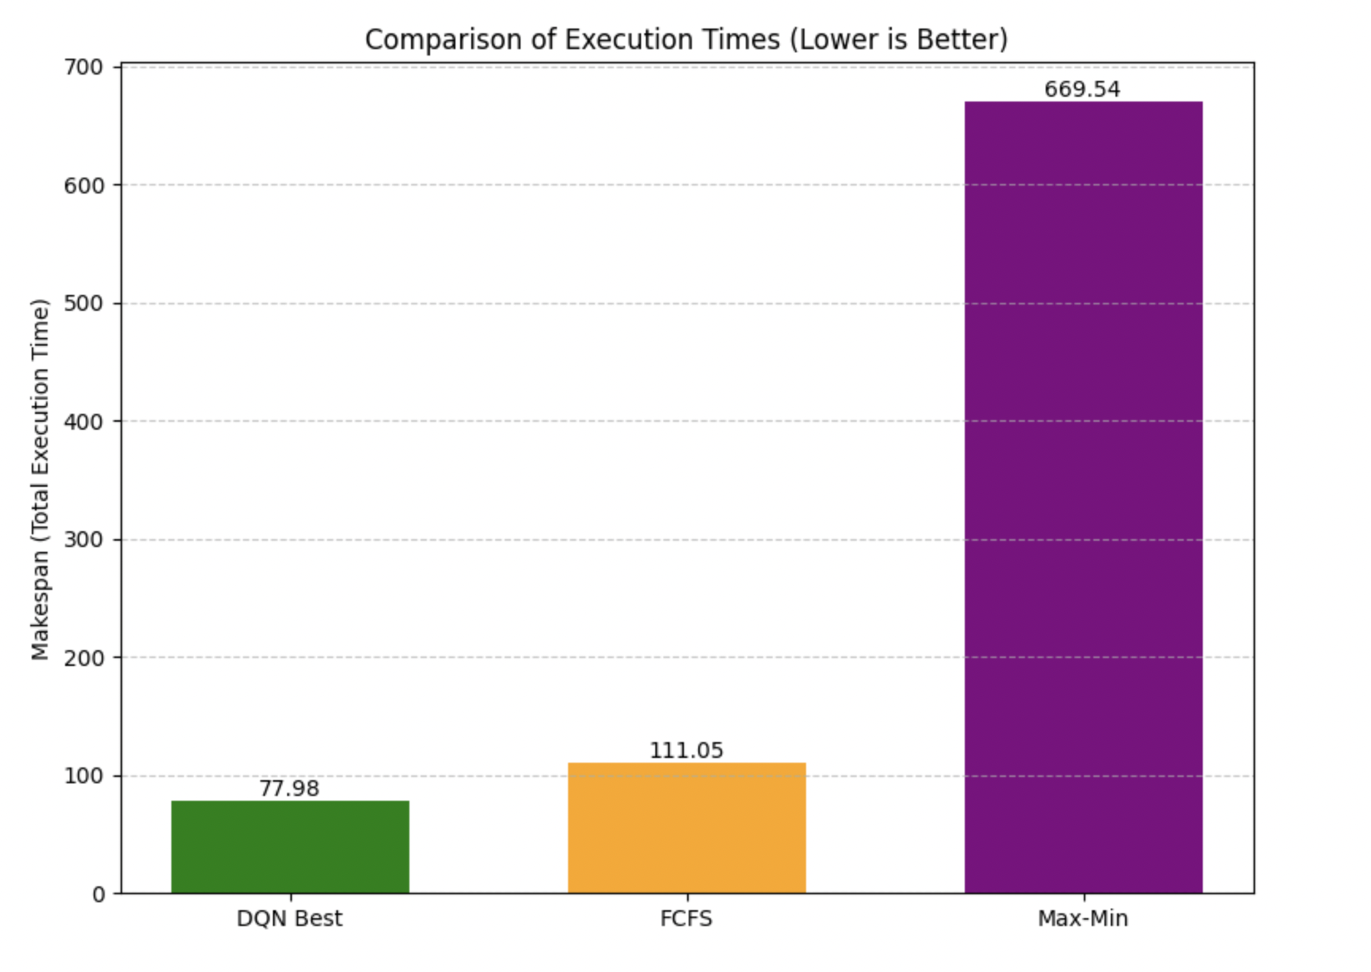
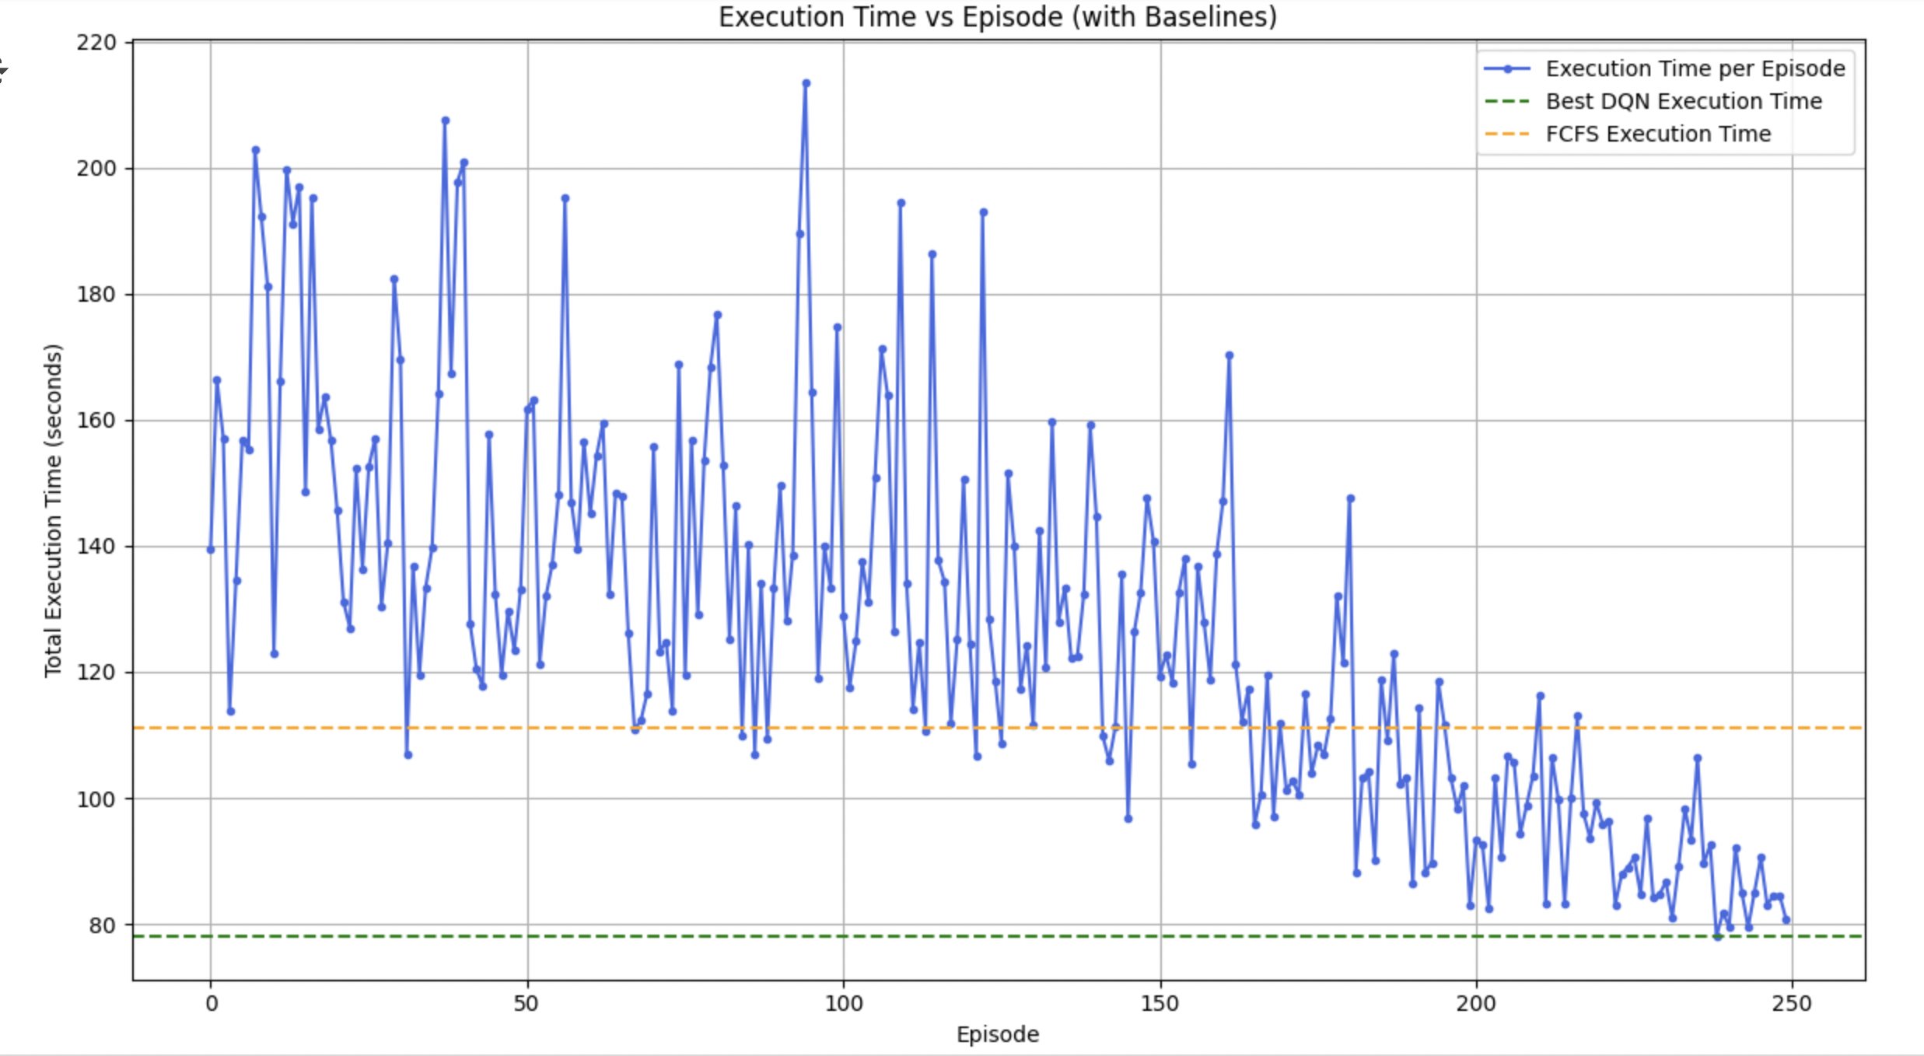
Performance Analysis with varying number of tasks and virtual machines:-
No. of tasks: 100, No. of VMs: 15

Slide 13
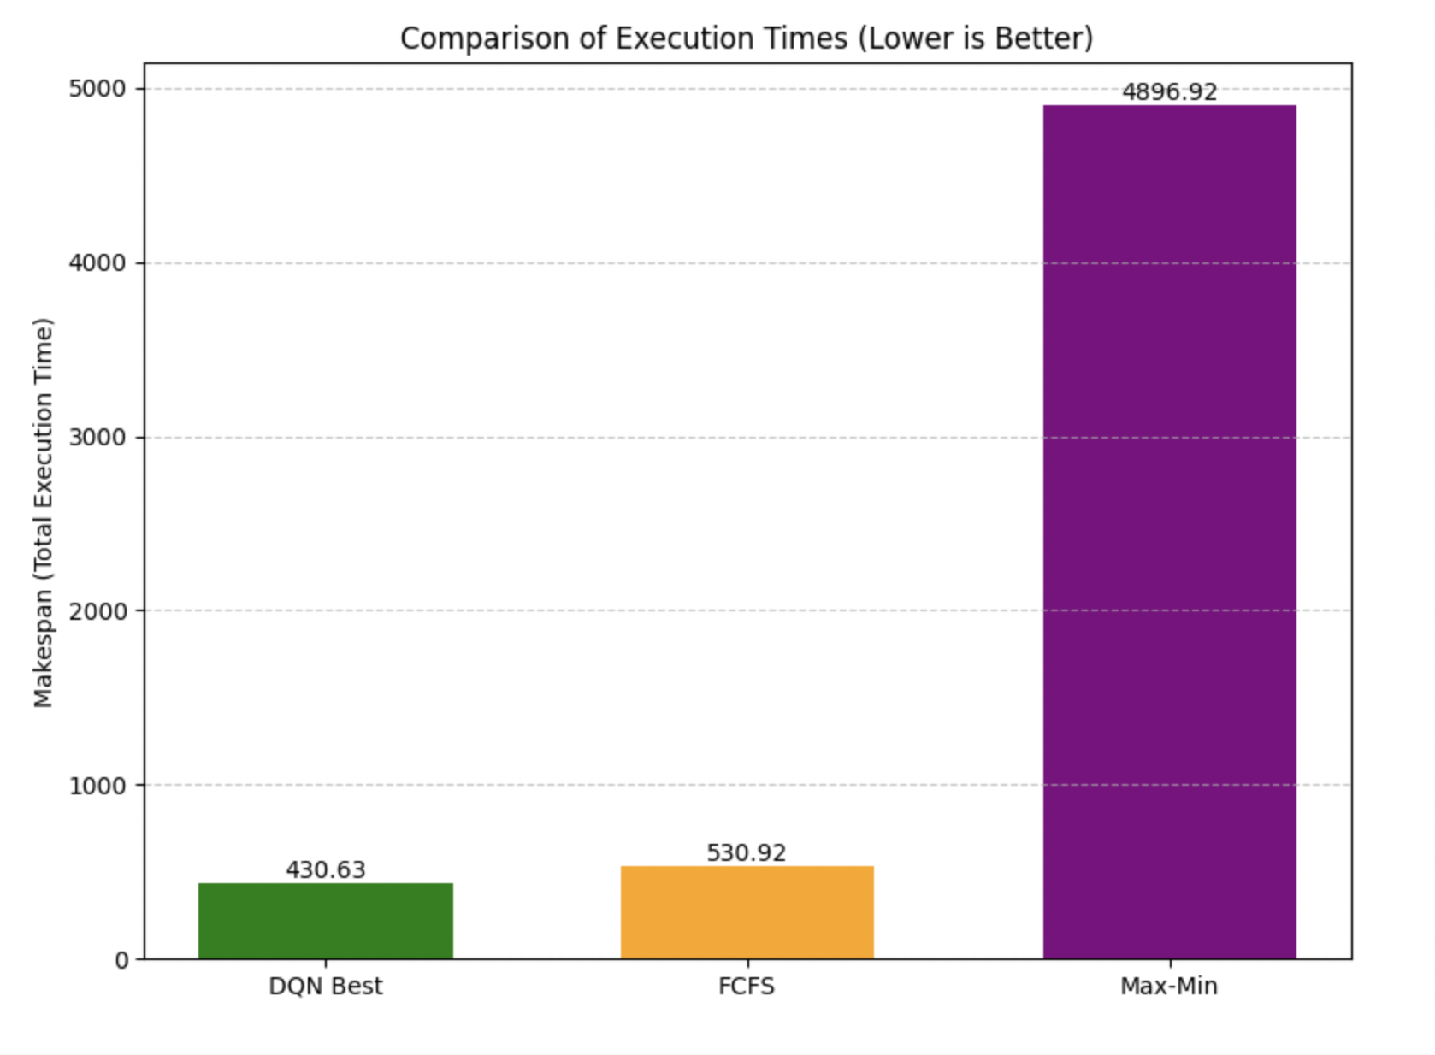
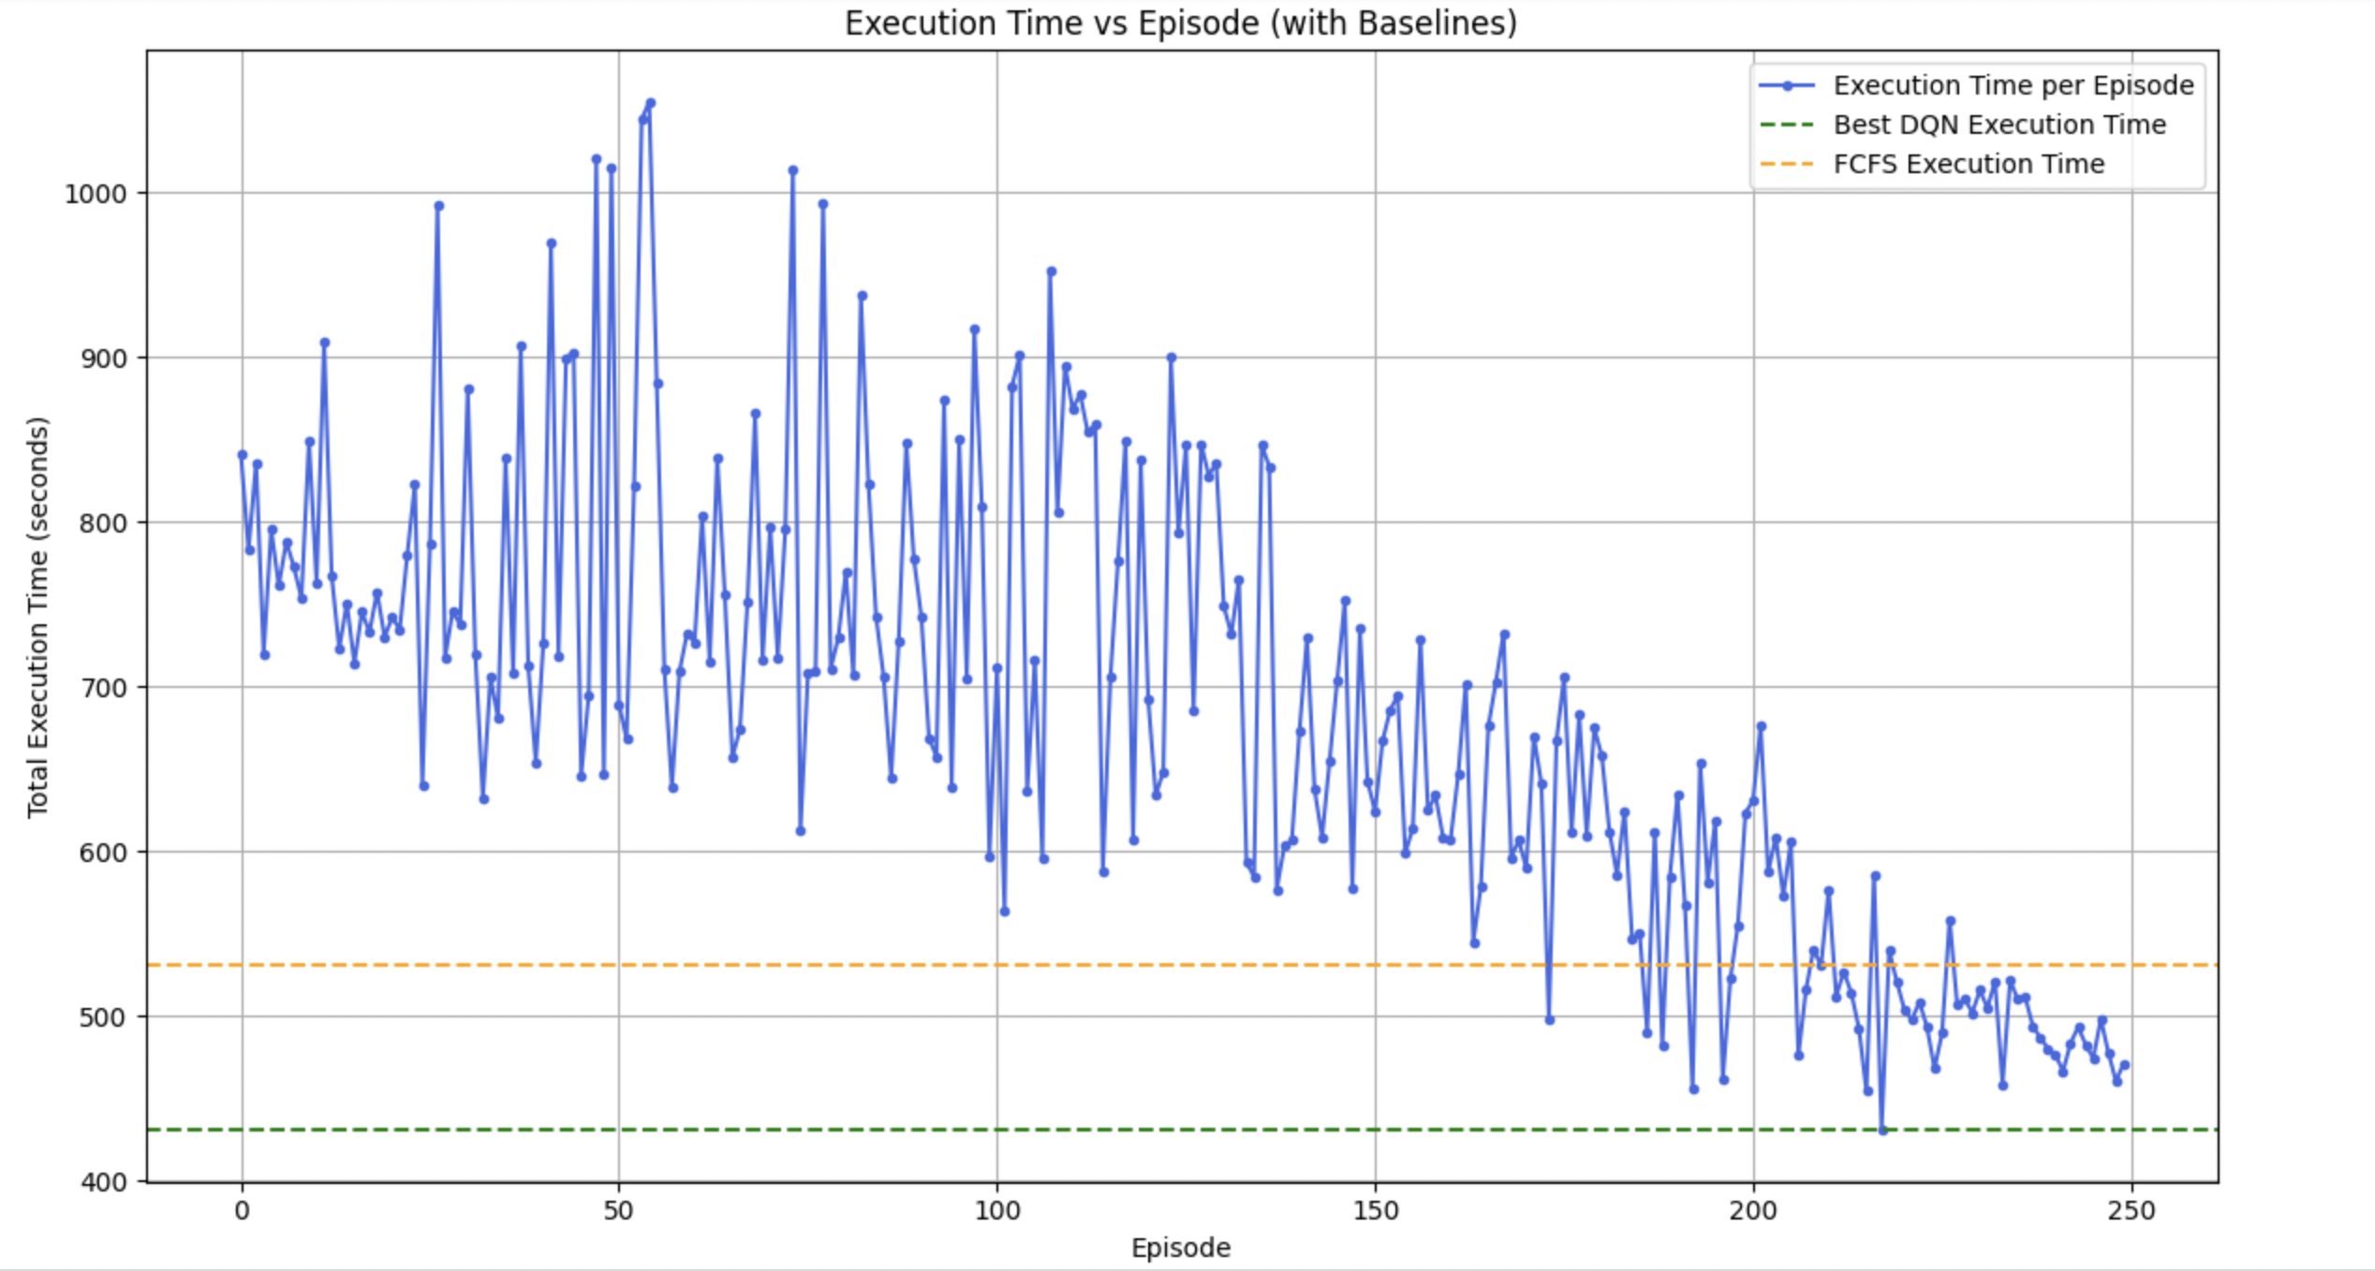
Performance Analysis with varying number of tasks and virtual machines:-
No. of tasks: 500, No. of VMs: 5

Slide 14
Performance Points:
DQN consistently achieves the lowest execution time across all task-VM configurations.
In all setups, reward per episode increases, indicating successful learning by DQN.
Execution time reduces with more training episodes, showing DQN adapts and optimizes.
FCFS and Max-Min are static algorithms and perform worse compared to DQN.
The DQN model scales better with increasing tasks and VMs.
Tasks | VMs | Best Performing Method | Reward Trend (DQN) | Execution Time Trend (DQN)
50 | 5 | DQN | Increasing | Decreasing
100 | 5 | DQN | Increasing | Decreasing
100 | 10 | DQN | Increasing | Decreasing
100 | 15 | DQN | Increasing | Decreasing
500 | 5 | DQN | Increasing | Decreasing

Slide 15
Conclusion :
The Q-learning-based workflow scheduling model shows promising results with dynamic and adaptive task-to-VM assignment.
Ambiguities in the reward function were identified, and refining it is key to improving learning and overall scheduling efficiency.
Testing with different numbers of tasks and VMs provided deeper insights into scalability and performance.
DQN consistently outperformed traditional algorithms (FCFS, Max-Min) in terms of lower execution time and better learning over episodes.
Future optimization efforts will focus on refining the reward structure, tuning hyperparameters, and improving cost-aware scheduling strategies.

Slide 16
THANK YOU

